Slide 1
CS97: Introduction to Data Science
2: Know Your Data
Instructor: Shichang Zhang
shichang@ucla.edu

Slide 2
Recap
Data Science Life Cycle
Ask an interesting question
Get the Data
Explore and Preprocess the Data
Model the Data
Communicate/Visualize the Results

Slide 3
Content
Vector/Tabular Data
Data Exploration: Descriptive Statistics
Data Exploration: Data Visualization
Data Preprocessing

Slide 4
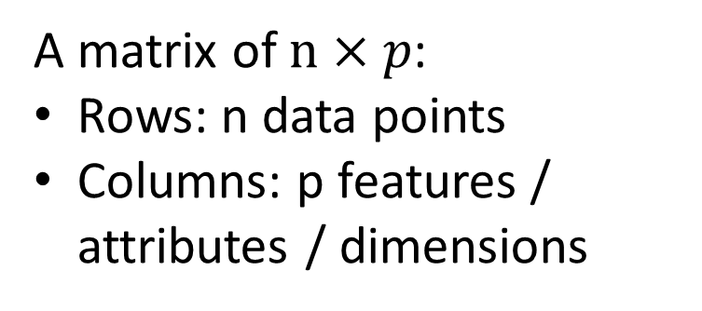
Example
Living Area (sqft) | # of Beds | Has pool | Price (1000$)
2104 | 3 | Yes | 400
1600 | 3 | No | 330
2400 | 3 | No | 369
1416 | 2 | No | 232
3000 | 4 | Yes | 540
A matrix of $n×p$:
Rows: n data points
Columns: p features / attributes / dimensions

Slide 5
Attribute Type
Numerical
E.g., height, income
Categorical / discrete
E.g., Sex, Race

Slide 6
Categorical Attribute Types
Nominal: categories, states, or “names of things”
Hair_color = {auburn, black, blond, brown, grey, red, white}
marital status, occupation, ID numbers, zip codes
Binary
Nominal attribute with only 2 states (0 and 1)
Symmetric binary: both outcomes equally important
Asymmetric binary: outcomes not equally important.
e.g., medical test (positive vs. negative)
Convention: assign 1 to most important outcome (e.g., HIV positive)
Ordinal
Values have a meaningful order (ranking) but magnitude between successive values is not known.
Size = {small, medium, large}, grades, army rankings

Slide 7



Please download and install the Slido app on all computers you use
Audience Q&A Session
ⓘ Start presenting to display the audience questions on this slide.

Slide 8
Content
Vector/Tabular Data
Data Exploration: Descriptive Statistics
Data Exploration: Data Visualization
Data Preprocessing

Slide 9
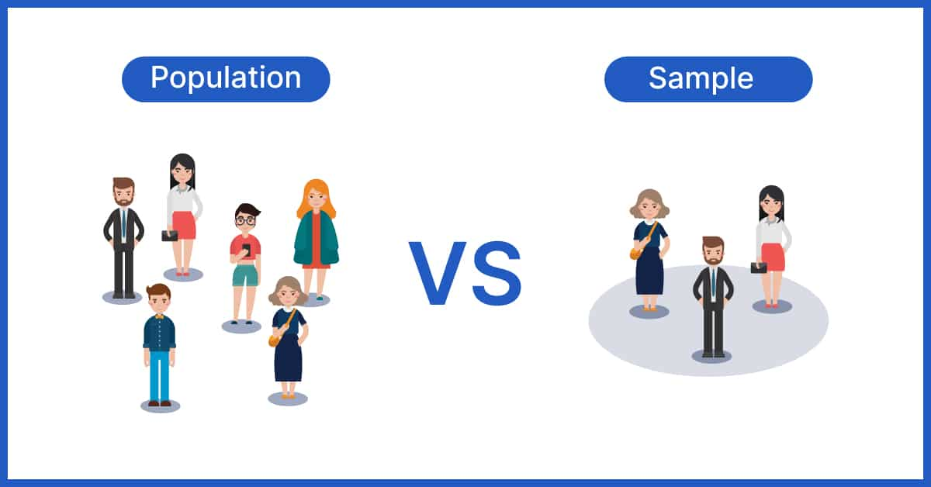
Population vs. Sample
A set of data points is a sample from a population:
A population is the entire set of objects or events under study.
E.g., all the people in LA
E.g., all the houses in a region
A sample is a “representative” subset of the objects or events under study. Needed because it’s impossible or intractable to obtain or compute with population data.

Slide 10
Biases in samples:
Selection bias: some subjects or records are more likely to be selected
Volunteer/nonresponse bias: subjects or records who are not easily available are not represented

Slide 11
“About 10 percent of the 1.6 million inmates in America’s prisons are serving life sentences; another 11 percent are serving over 20 years.”
source: http://www.nytimes.com/2012/02/26/health/dealing-with-dementia-among-aging-criminals.html? pagewanted=all

Slide 12
Length-biasing Paradox
How would you measure the average prison sentence?

Slide 13
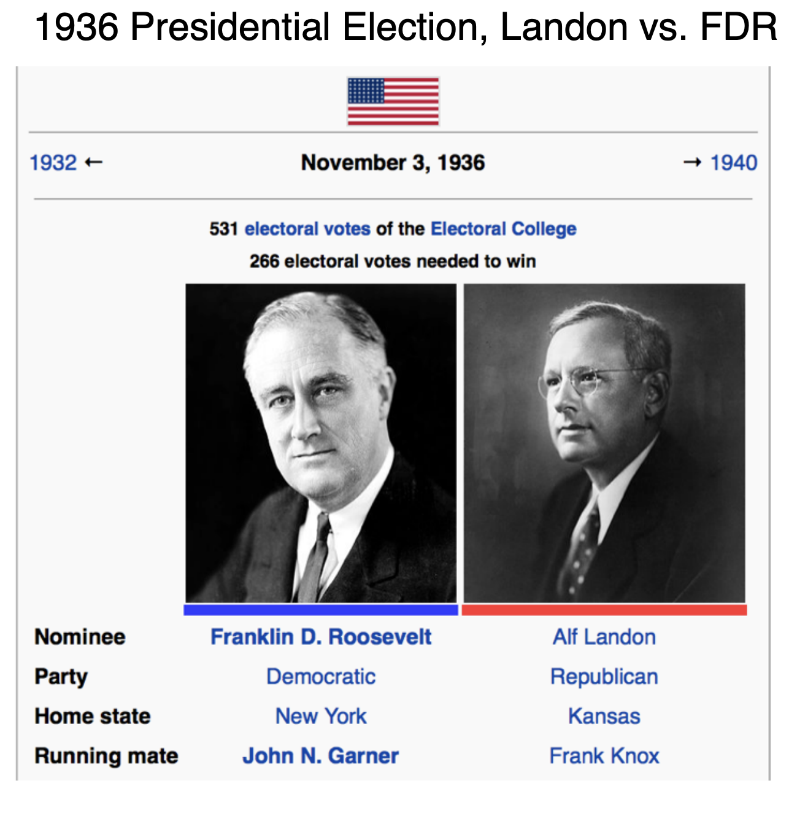

Slide 14
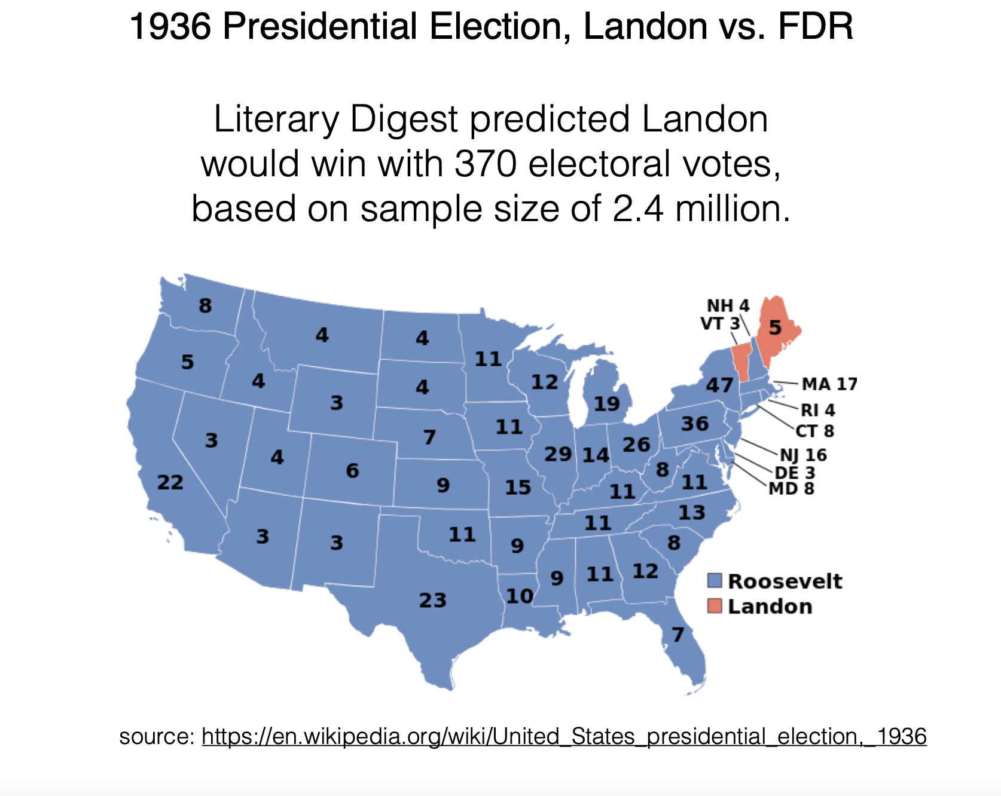
Survey Result:
Actual Result:

Slide 15
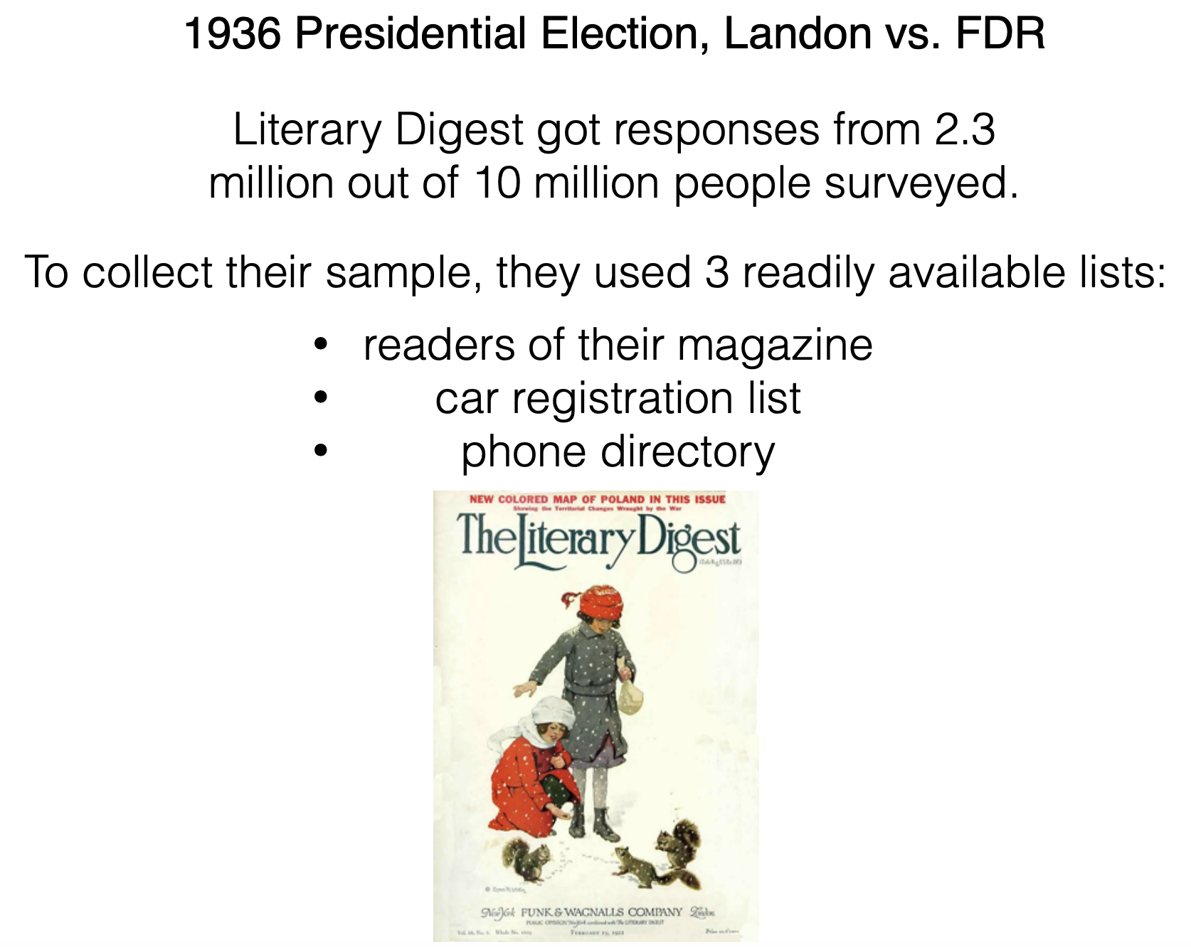

Slide 16
Basic Statistical Descriptions of Data
Central Tendency
Dispersion of the Data

Slide 17
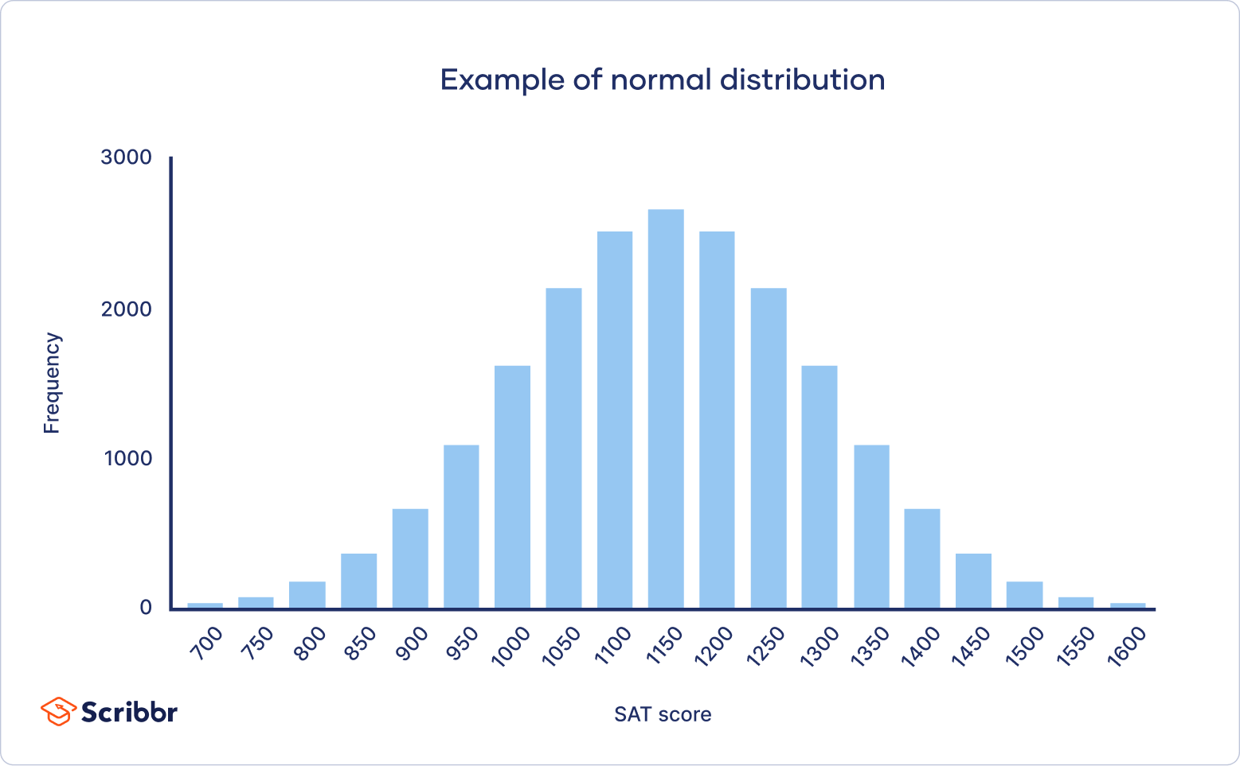
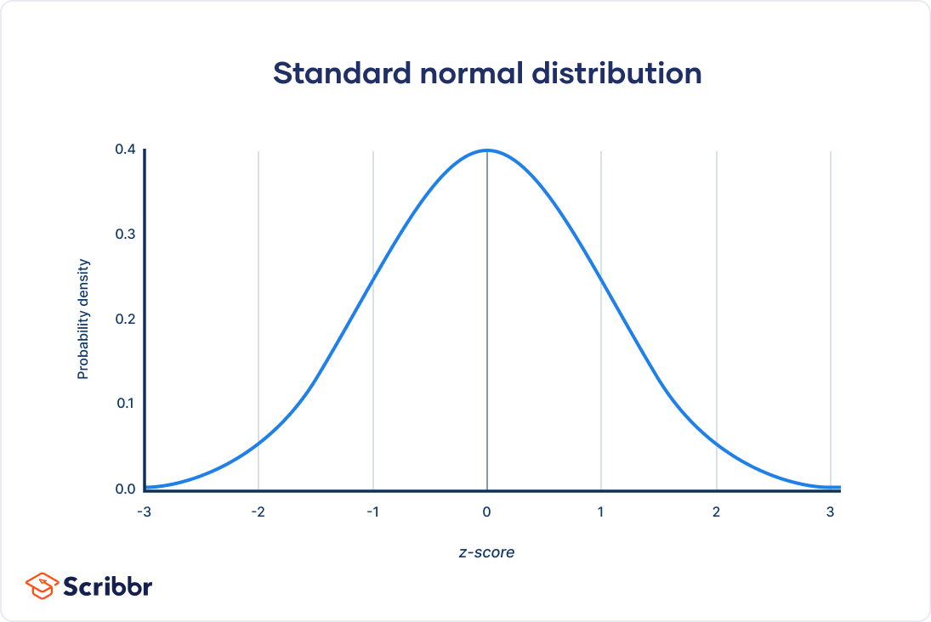
Data Distribution
Describing data

Slide 18
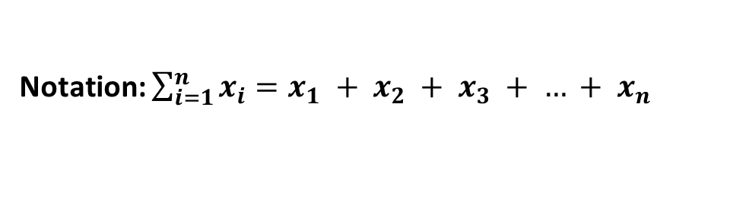
Measuring the Central Tendency
Mean (algebraic measure) (sample vs. population):
Note: n is sample size and N is population size.
Weighted arithmetic mean:
Median:
Defined given a measure of ordering.
Middle value if odd number of values, or average of the middle two values otherwise
Mode
Value that occurs most frequently in the data
Unimodal, bimodal, trimodal
Notation: $\sum_{i=1}^{n}{x_{i}}=x_{1} + x_{2} + x_{3} + … + x_{n}$
Notes:
950+2244=3194; middle number should be 1597

Slide 19
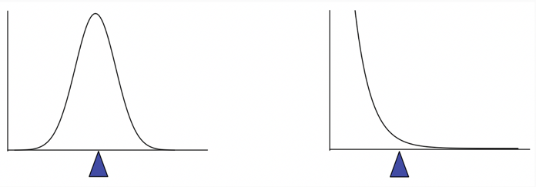
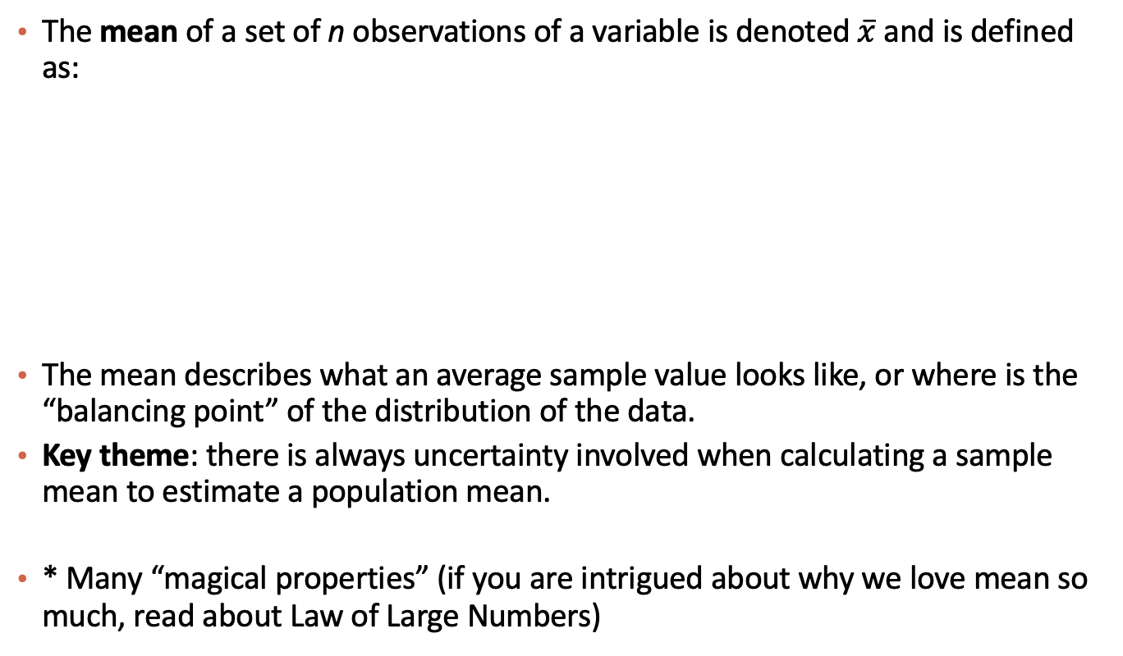
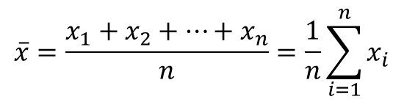
Mean
The mean of a set of n observations of a variable is denoted $\overline{x}$ and is defined as:
The mean describes what an average sample value looks like, or where is the “balancing point” of the distribution of the data.
Key theme: there is always uncertainty involved when calculating a sample mean to estimate a population mean.
* Many “magical properties” (if you are intrigued about why we love mean so much, read about Law of Large Numbers)
$$\overline{x}=\frac{x_{1}+x_{2}+…+x_{n}}{n}=\frac{1}{n}\sum_{i=1}^{n}{x_{i}}$$

Slide 20
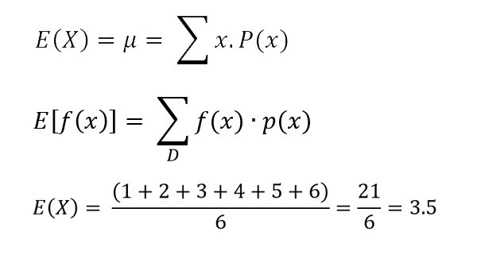
Weighted Mean and Expectation
Weighted mean
Expectation (Expected value)

Slide 21
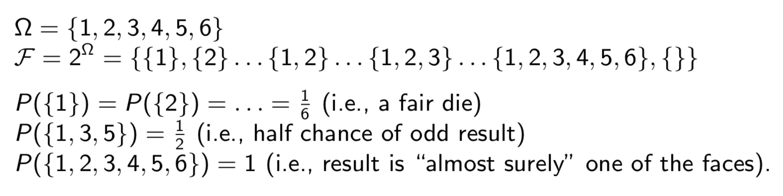
Probability
Example of rolling a die

Slide 22
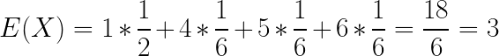
Weighted Mean and Expectation
Weighted mean
Expectation (Expected value)
Roll a die
Roll a die with three sides being 1 and no 2 or 3

Slide 23
Median
The median of a set of n number of observations in a sample, ordered by value, of a variable is is defined by
Example (already in order): Ages: 17, 19, 21, 22, 23, 23, 23, 38
Median = (22+23)/2 = 22.5
The median also describes what a typical observation looks like, or where is the center of the distribution of the sample of observations.

Slide 24
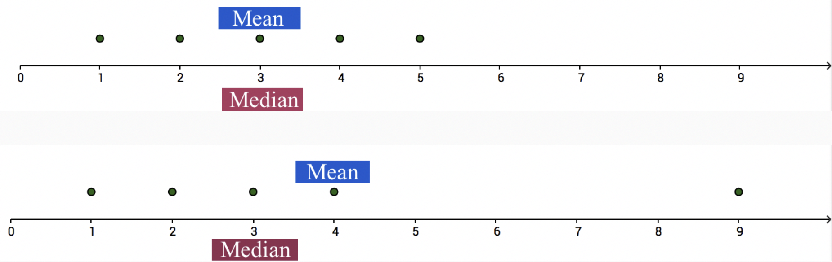
Mean vs. Median
The mean is sensitive to extreme values (outliers)

Slide 25
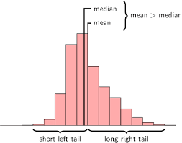
Mean, median, and skewness
The mean is sensitive to outliers:
The above distribution is called right-skewed since the mean is greater than the median. Note: skewness often “follows the longer tail”.

Slide 26
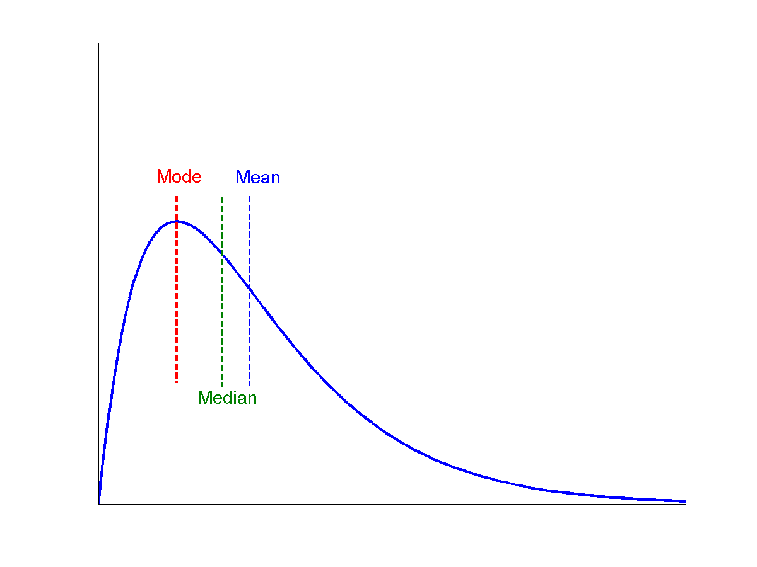
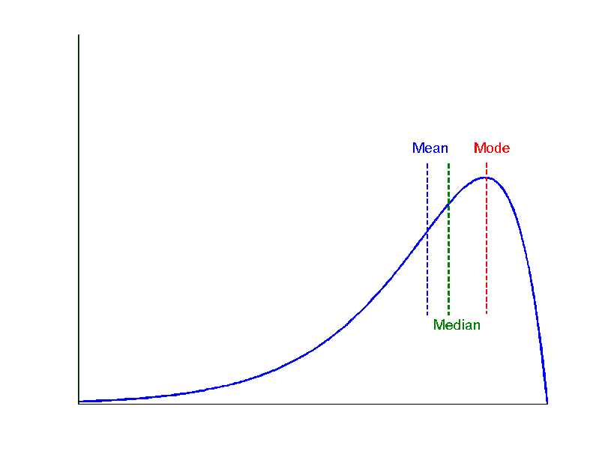
Symmetric vs. Skewed Data
Median, mean and mode of symmetric, positively (right) and negatively (left) skewed data
symmetric
positively skewed
negatively skewed

Slide 27

Please download and install the Slido app on all computers you use
Is income Positively or Negatively Skewed?
ⓘ Start presenting to display the poll results on this slide.

Slide 28
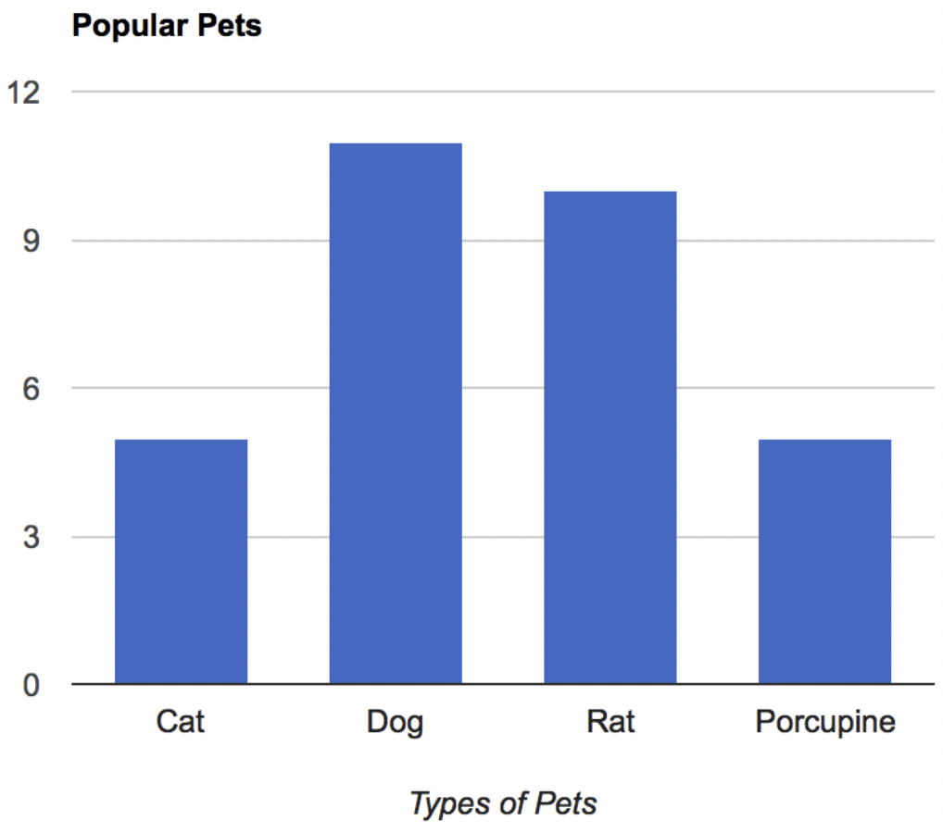
Regarding Categorical Variables...
For categorical variables, neither mean or median make sense. Why?
The mode might be a better way to find the most “representative” value.

Slide 29
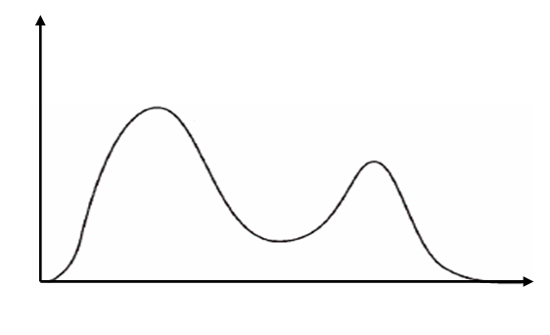
Unimodal and Bimodal

Slide 30
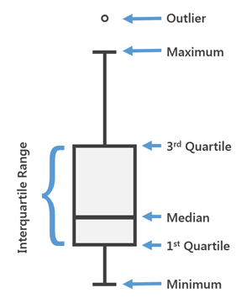
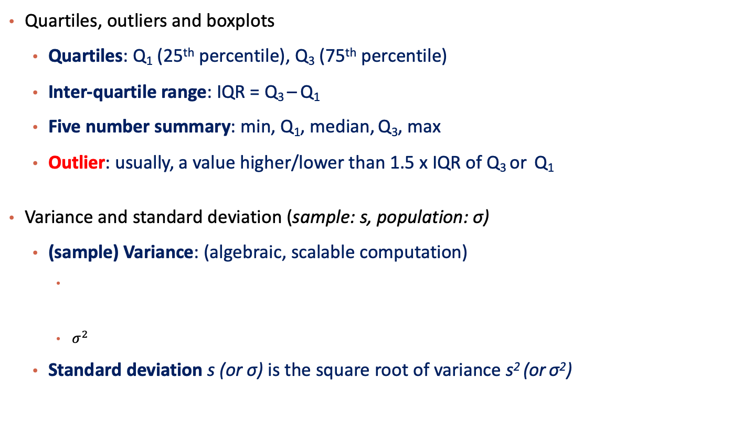
Measuring the Dispersion of Data
Quartiles, outliers and boxplots
Quartiles: Q₁ (25th percentile), Q₃ (75th percentile)
Inter-quartile range: IQR = Q₃ – Q₁
Five number summary: min, Q₁, median, Q₃, max
Outlier: usually, a value higher/lower than 1.5 x IQR of Q₃ or Q₁
Variance and standard deviation (sample: s, population: σ)
(sample) Variance: (algebraic, scalable computation)
$σ^{2}$
Standard deviation s (or σ) is the square root of variance s² (or σ²)
Box Plot

Slide 31
Measuring the Dispersion of Data
Quartiles, outliers and boxplots
Quartiles: Q₁ (25th percentile), Q₃ (75th percentile)
Inter-quartile range: IQR = Q₃ – Q₁
Five number summary: min, Q₁, median, Q₃, max
Outlier: usually, a value higher/lower than 1.5 x IQR of Q₃ or Q₁
Box Plot

Slide 32
Measures of Spread: Range
The spread of a sample of observations measures how well the mean or median describes the sample.
One way to measure spread of a sample of observations is via the range.
Range = Maximum Value - Minimum Value

Slide 33
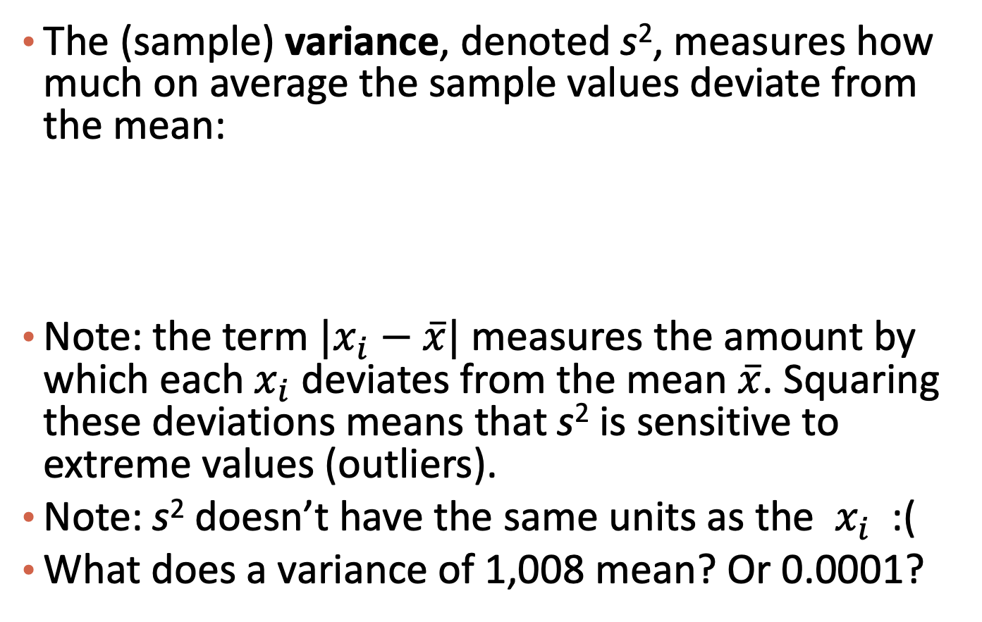
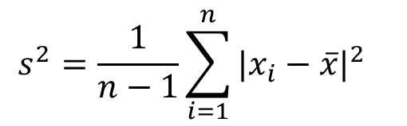
Measures of Spread: Variance
The (sample) variance, denoted s², measures how much on average the sample values deviate from the mean:
Note: the term ${|x}_{i}−\overline{x}|$measures the amount by which each $x_{i}$ deviates from the mean $\overline{x}$. Squaring these deviations means that s² is sensitive to extreme values (outliers).
Note: s² doesn’t have the same units as the $x_{i}$ :(
What does a variance of 1,008 mean? Or 0.0001?
$$s^{2}=\frac{1}{n−1}\sum_{i=1}^{n}{{{|x}_{i}−\overline{x}|}^{2} }$$

Slide 34
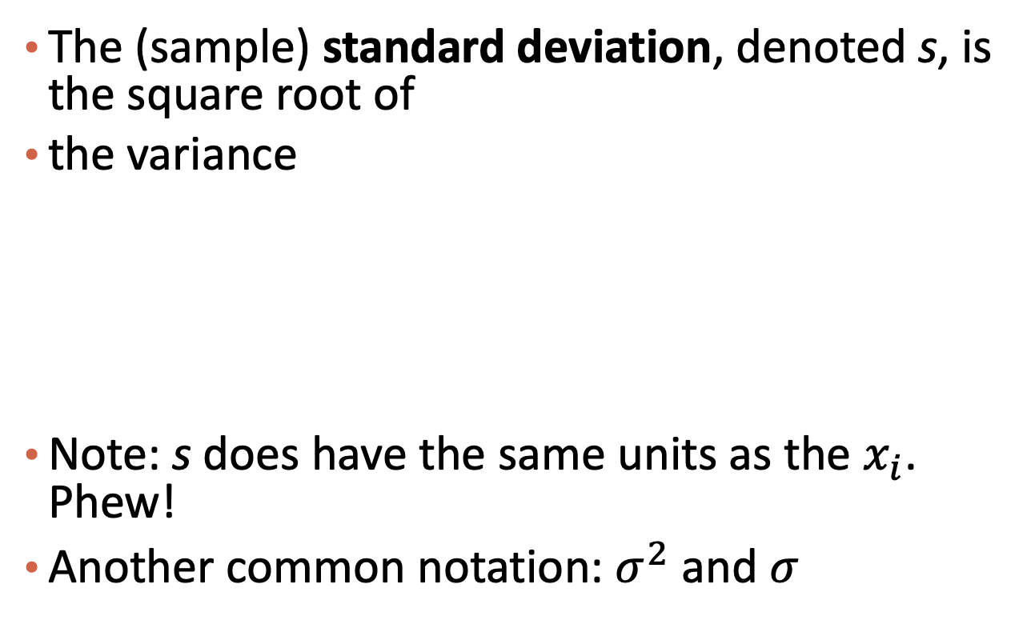
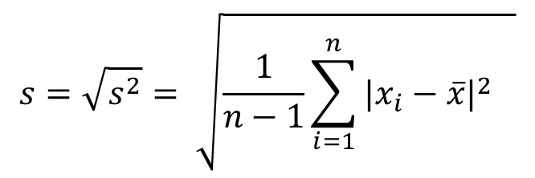
Measures of Spread: Standard Deviation
The (sample) standard deviation, denoted s, is the square root of
the variance
Note: s does have the same units as the $x_{i}$. Phew!
Another common notation: $σ^{2}$ and $σ^{}$
$$s=\sqrt{s^{2}}= \sqrt{\frac{1}{n−1}\sum_{i=1}^{n}{{{|x}_{i}−\overline{x}|}^{2} }}$$

Slide 35
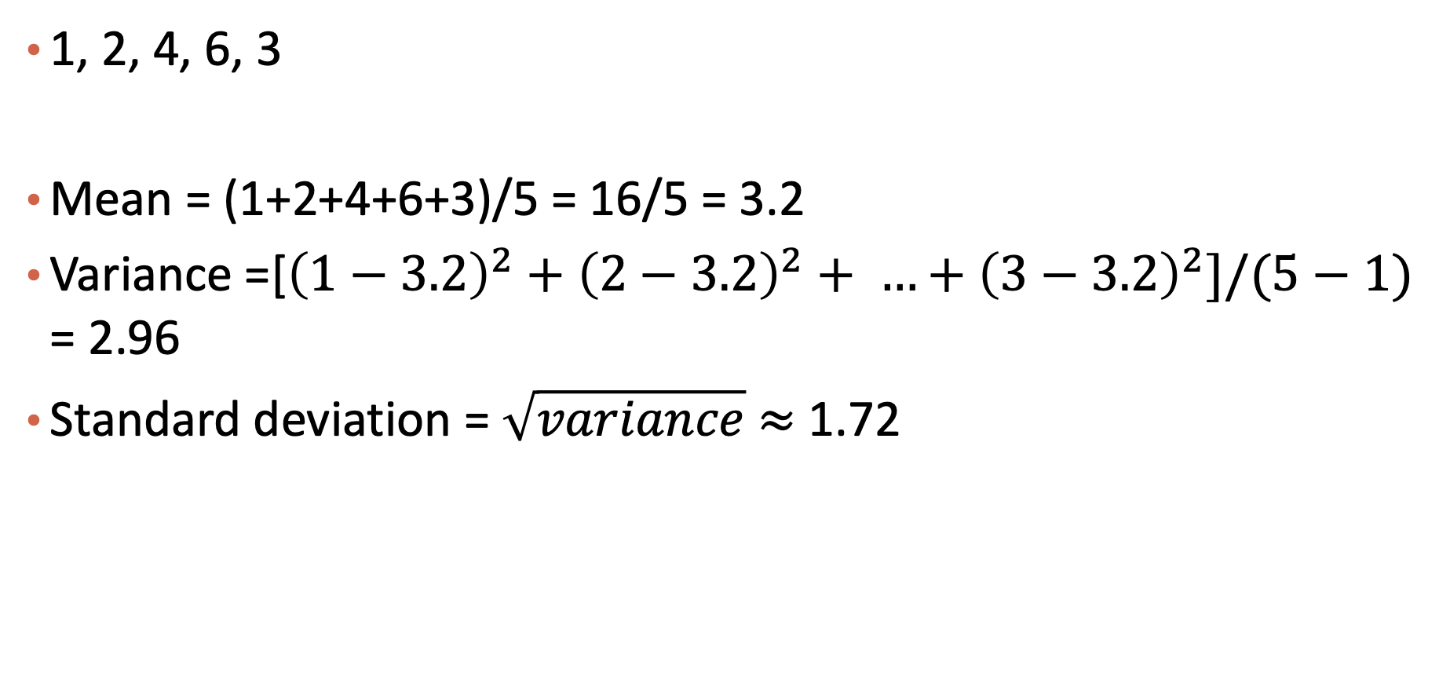
Exercise
1, 2, 4, 6, 3
Mean = (1+2+4+6+3)/5 = 16/5 = 3.2
Variance =[${\left(1−3.2\right)}^{2}+{\left(2−3.2\right)}^{2}+ …+{\left(3−3.2\right)}^{2}]/(5−1)$ = 2.96
Standard deviation = $\sqrt{variance}$ $≈$ 1.72

Slide 36
Please download and install the Slido app on all computers you use
Audience Q&A Session
ⓘ Start presenting to display the audience questions on this slide.

Slide 37
Content
Vector/Tabular Data
Data Exploration: Descriptive Statistics
Data Exploration: Data Visualization
Data Preprocessing

Slide 38
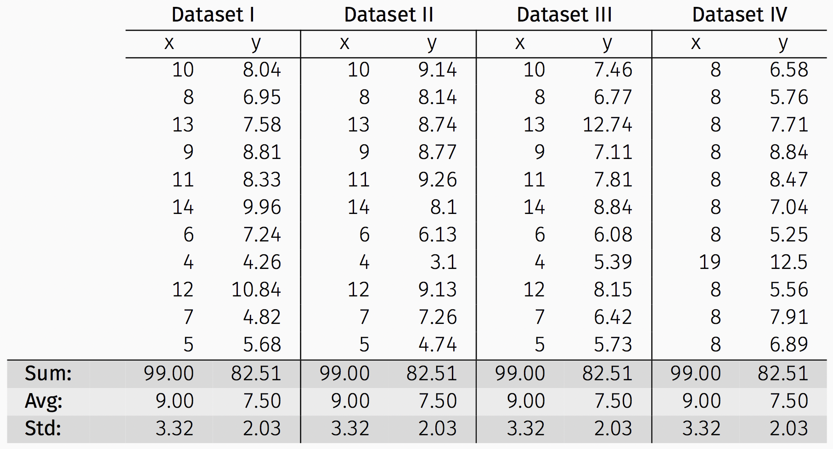
Anscombe’s Data
The following four data sets comprise the Anscombe’s Quartet; all four sets of data have identical simple summary statistics.

Slide 39
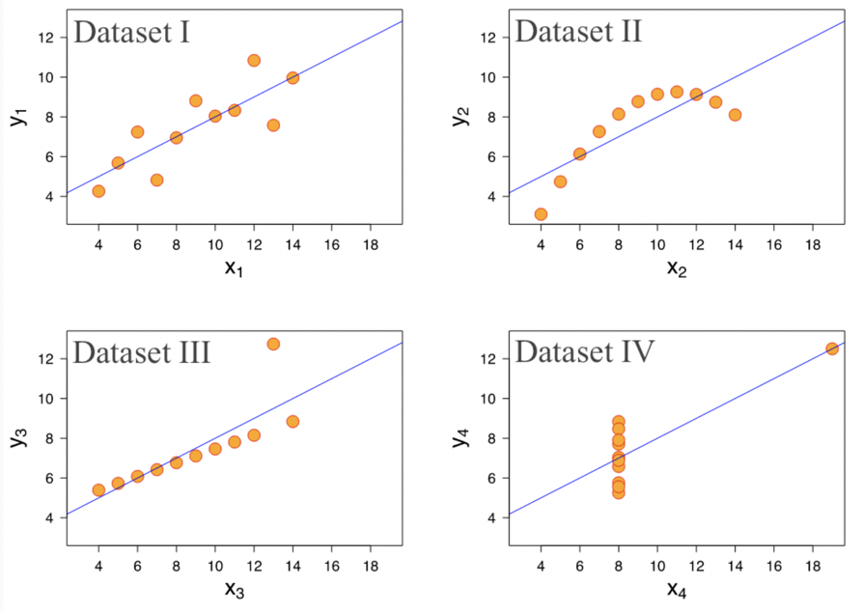
Anscombe’s Data (cont.)
Summary statistics clearly don’t tell the story of how they differ. But a picture can be worth a thousand words:

Slide 40

Please download and install the Slido app on all computers you use
Why do summary statistics not always work?
ⓘ Start presenting to display the poll results on this slide.

Slide 41
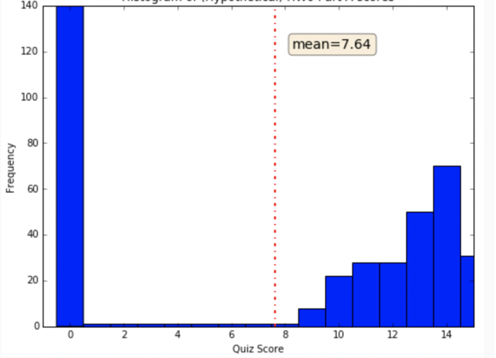
More Visualization Motivation
If I tell you that the average score for a Homework is: 7.64/15 = 50.9%, what does that suggest?
And what does the graph suggest?

Slide 42
Types of Visualizations
What do you want your visualization to show about your data?
Distribution: how a variable or variables in the dataset distribute over a range of possible values.
Relationship: how the values of multiple variables in the dataset relate
Composition: how the dataset breaks down into subgroups
Comparison: how trends in multiple variable or datasets compare

Slide 43
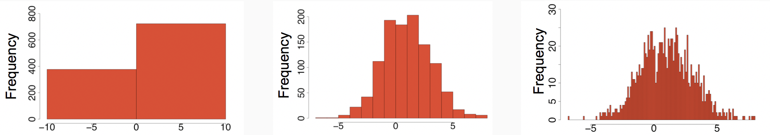
Histograms to visualize distribution
A histogram is a way to visualize how 1-dimensional data is distributed across certain values.
Note: Trends in histograms are sensitive to number of bins.

Slide 44
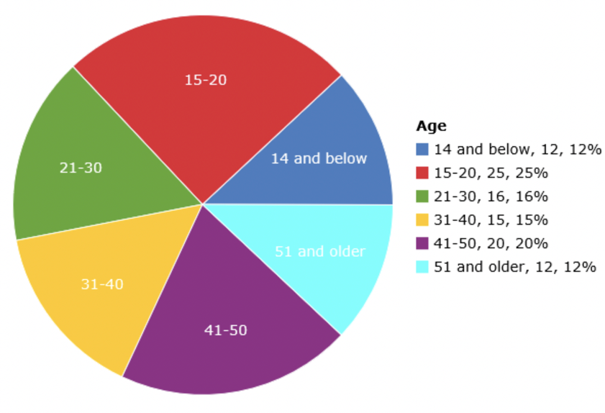
Pie chart for a categorical variable?
A pie chart is a way to visualize the static composition (aka, distribution) of a variable (or single group).
Pie charts are often frowned upon (and bar charts are used instead). Why?
Notes:
hard to compare the area

Slide 45
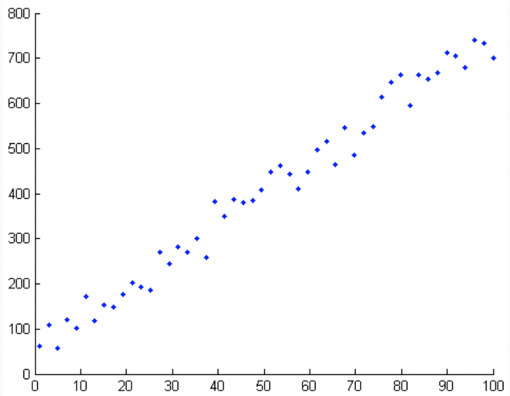
Scatter plots to visualize relationships
A scatter plot is a way to visualize the relationship between two different attributes of multi-dimensional data.

Slide 46
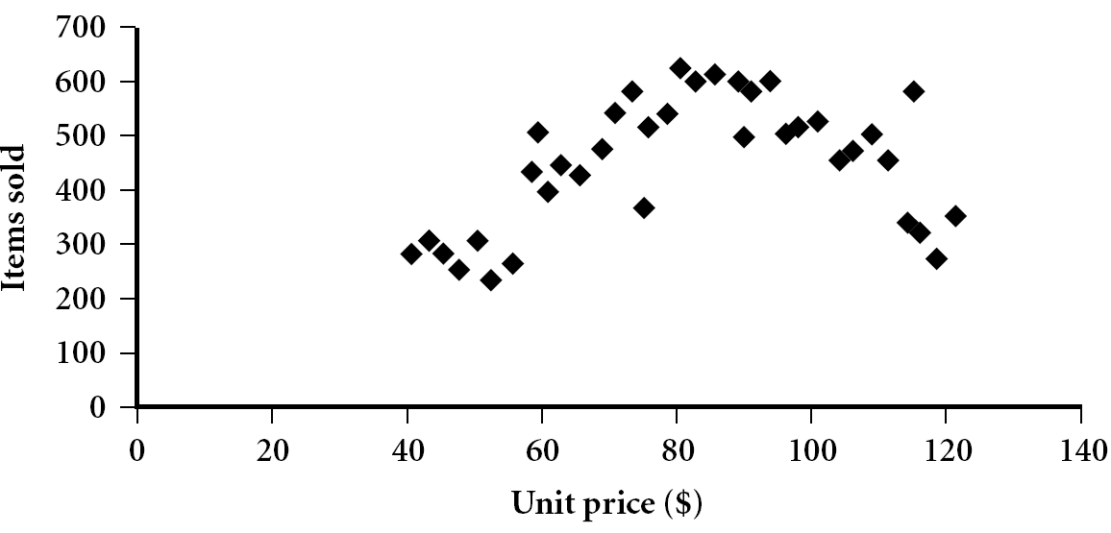
Scatter plot
Provides a first look at bivariate data to see clusters of points, outliers, etc
Each pair of values is treated as a pair of coordinates and plotted as points in the plane
Notes:
Need a better and more MEANINGFUL scatter plot! -JH

Slide 47
Positively and Negatively Correlated Data
The left half fragment is positively correlated
The right half is negative correlated

Slide 48
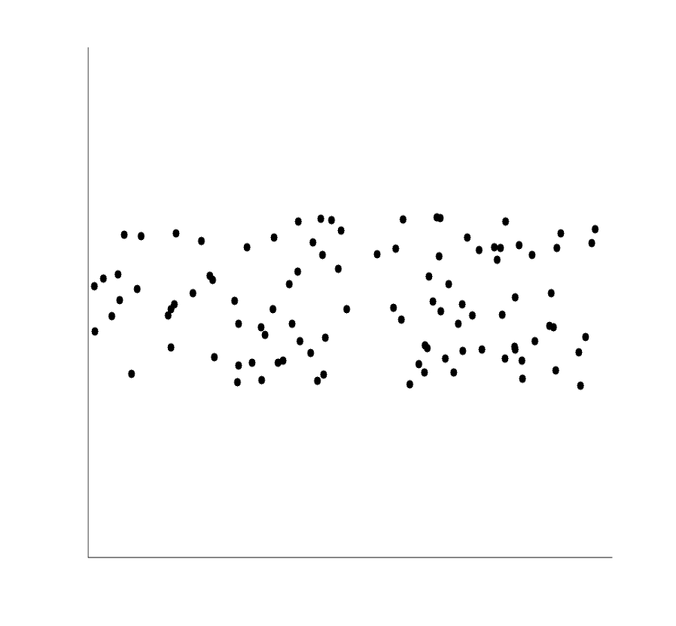
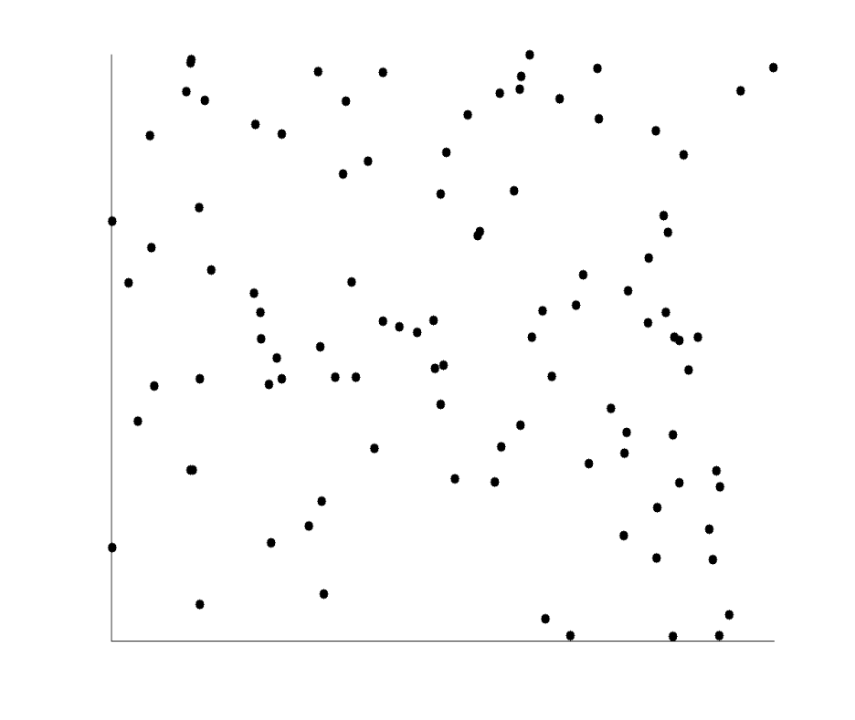
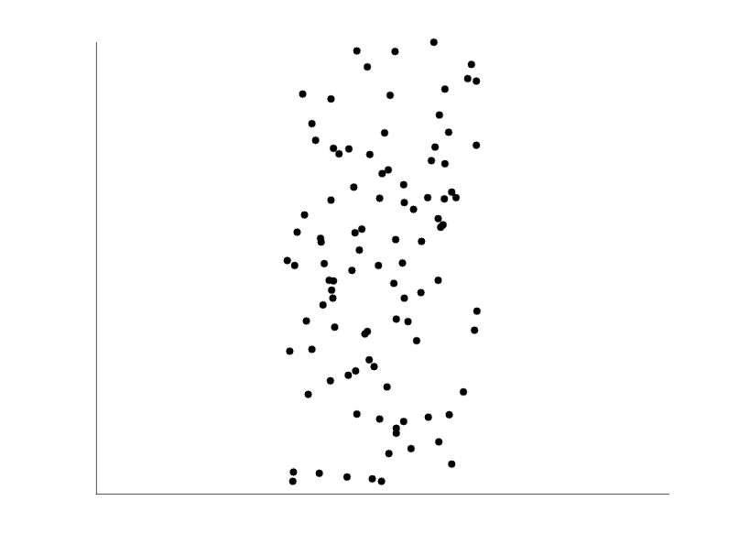
Uncorrelated Data

Slide 49
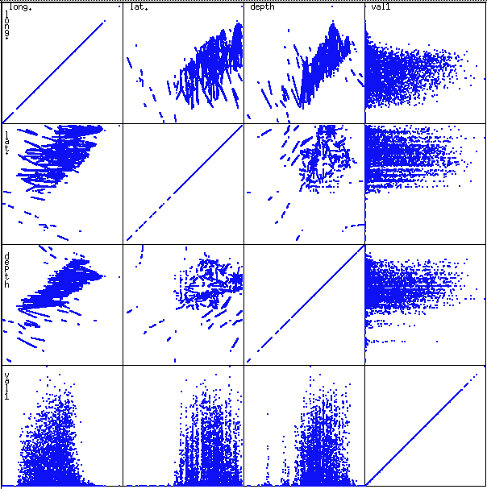
Scatterplot Matrices
Used by ermission of M. Ward, Worcester Polytechnic Institute
Matrix of scatterplots (x-y-diagrams) of the k-dim. data [total of $\left(\begin{matrix}k \\ 2\end{matrix}\right)+k$ unique scatterplots]

Slide 50
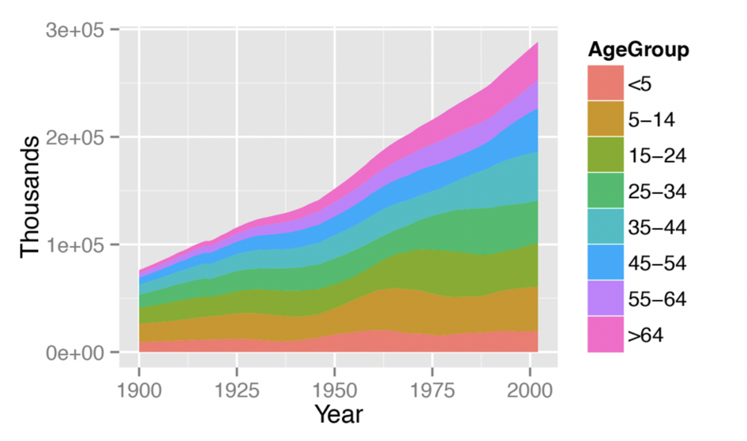
Stacked area graph to show trend over time
A stacked area graph is a way to visualize the composition of a group as it changes over time (or some other quantitative variable). This shows the relationship of a categorical variable (AgeGroup) to a quantitative variable (year).

Slide 51
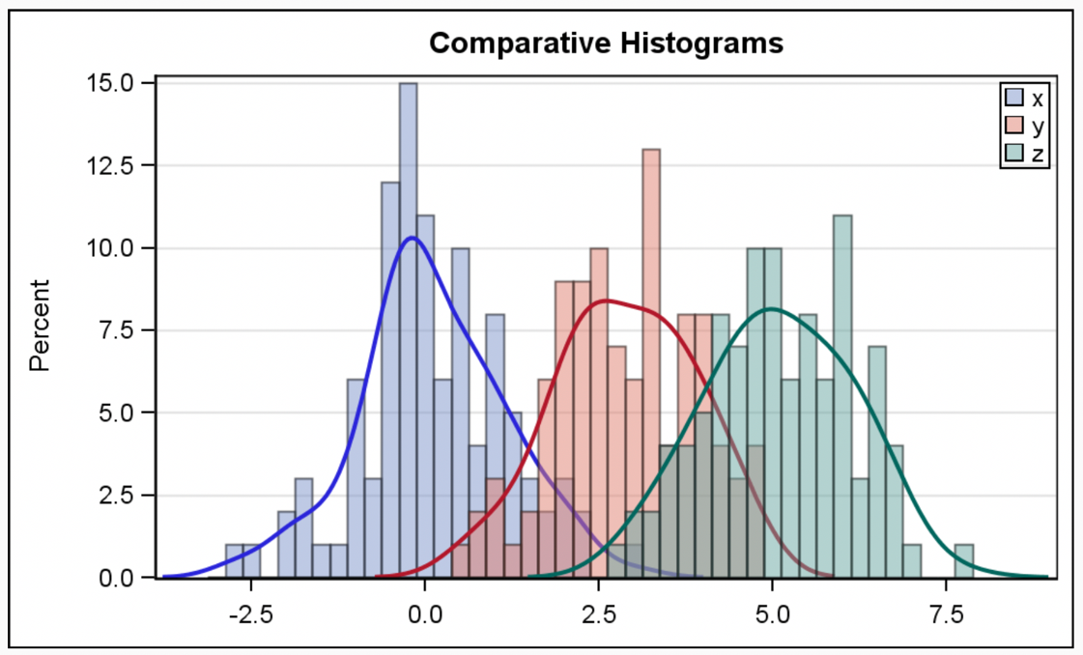
Multiple histograms
Plotting multiple histograms (and kernel density estimates of the distribution, here) on the same axes is a way to visualize how different variables compare (or how a variable differs over specific groups).

Slide 52
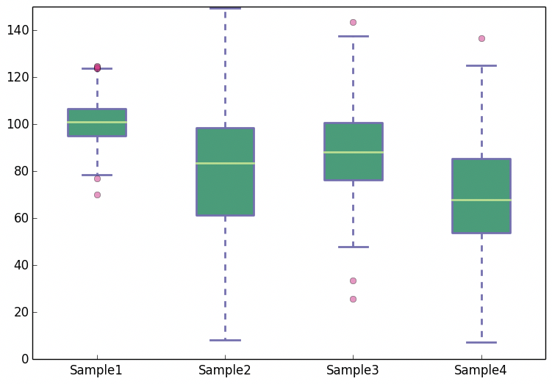
Boxplots
A boxplot is a simplified visualization to compare a quantitative variable across groups. It highlights the range, quartiles, median and any outliers present in a data set.

Slide 53
Challenges in Visualization
Most common challenges:
Data is too high dimensional (how do you plot 100 variables on the same set of axes?)
We can only perceive 3D object.
*if you are curious, search dimensionality reduction.
Different types of variables exist together (some numerical, some categorical)
Need some conversion scheme.
There are plot types for categorical data only (Visualizing categorical data — seaborn 0.12.2 documentation (pydata.org))

Slide 54
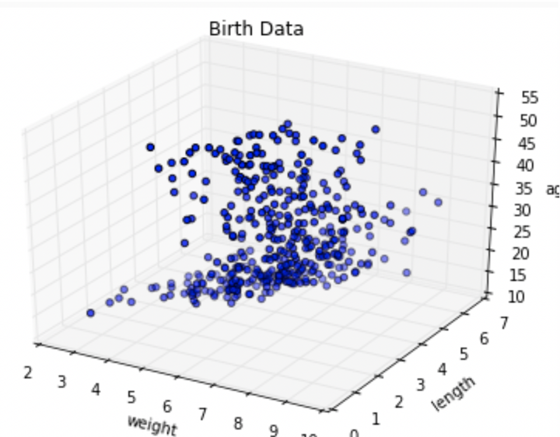
More dimensions not always better
When the data is high dimensional, a scatter plot of all data attributes can be impossible or unhelpful

Slide 55
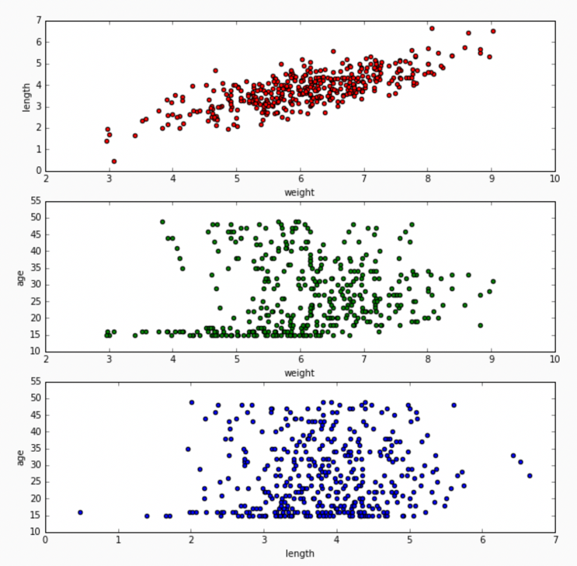
Reducing complexity
Relationships may be easier to spot by producing multiple plots of lower dimensionality.

Slide 56
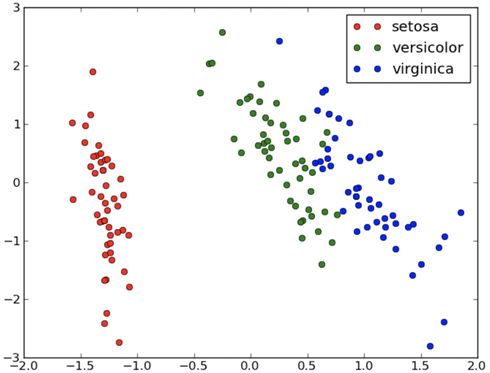
Reducing complexity
For 3D data, color coding a categorical attribute can be “effective”
Except when it’s not effective. What could be a better choice?
This visualizes a set of Iris measurements. The variables are: petal length, sepal length, Iris type (setosa, versicolor, virginica).

Slide 57
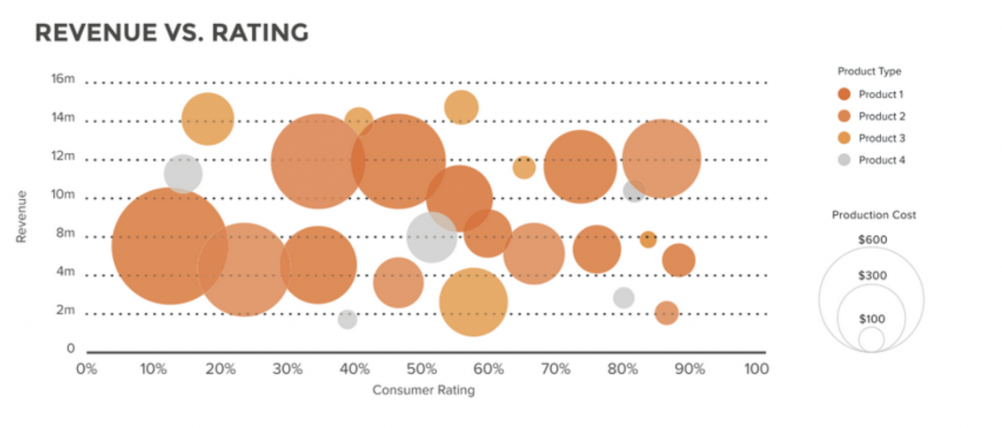
3D can work
For 3D data, a quantitative attribute can be encoded by size in a bubble chart.
The above visualizes a set of consumer products. The variables are: revenue, consumer rating, product type and product cost.
Key takeaway: in some cases, geometric objects can hold some useful information (don’t think everything as a point)

Slide 58
Content
Vector/Tabular Data
Data Exploration: Descriptive Statistics
Data Exploration: Data Visualization
Data Preprocessing

Slide 59
Handling Missing Data
Simple solution: drop the row or column
Slightly better solution: replace missing value with mean of median
Living Area (sqft) | # of Beds | Has pool | Price (1000$)
2104 | 3 | Yes | 400
1600 | 3 | No | 330
2400 | 3 | No | 369
1416 | N/A | No | 232
3000 | 4 | Yes | 540

Slide 60
Handling Outliers
Identify the outlier using the outlier definition
E.g., below 1.5 * IQR of the Q1; beyond +/-3*standard deviation of the mean
Drop the row
Living Area (sqft) | # of Beds | Has pool | Price (1000$)
2104 | 3 | Yes | 400
1600 | 3 | No | 330
2400 | 3 | No | 369
1416 | 2 | No | 232
3000 | 4 | Yes | 1

Slide 61
Data Preparation: Preparing features and label
Features: x = {living area, # of Beds, Has pool}
Label: y = {price}
Living Area (sqft) | # of Beds | Has pool | Price (1000$)
2104 | 3 | Yes | 400
1600 | 3 | No | 330
2400 | 3 | No | 369
1416 | 2 | No | 232
3000 | 4 | Yes | 540

Slide 62
Feature Transformation
Add new feature
E.g., living area per bed = living area / # of Beds
Transform categorial features to numerical values
Binary case: E.g., Has pool: {Yes, no} => {1,0}
More then two values: E.g., color = {red, blue, yellow} =>{Is_red, Is_blue, Is_yellow} (One hot encoding)
Is_red | Is_blue | Is_yellow | Has pool
1 | 0 | 0 | 1
0 | 0 | 1 | 0
0 | 1 | 0 | 0
0 | 1 | 0 | 1
1 | 0 | 0 | 1

Slide 63
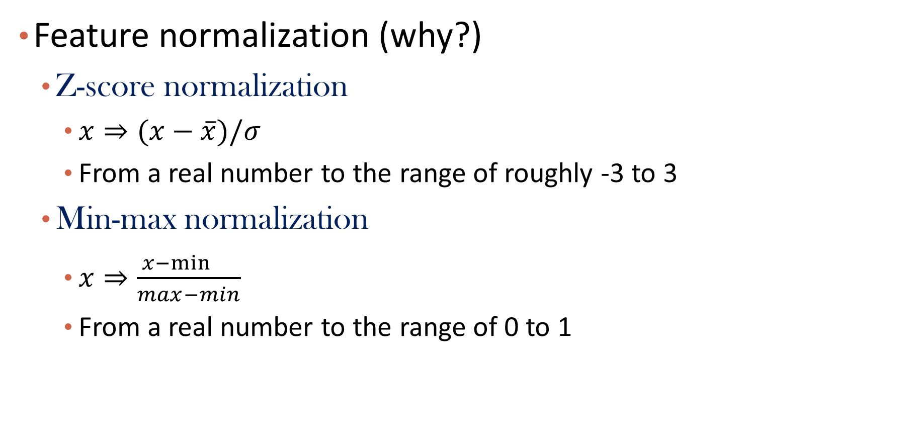
Feature Transformation (cont.)
Feature normalization (why?)
Z-score normalization
$x⇒(x−\overline{x})/σ$
From a real number to the range of roughly -3 to 3
Min-max normalization
$x⇒\frac{x−\min{}}{max−min}$
From a real number to the range of 0 to 1

Slide 64
Summary
Explore vector/tabular data
Attribute types
Basic statistics
Visualization
Data Preprocessing

Slide 65
Today’s Lab
Get familiar with
BruinLearn
Piazza
GradeScope
Review Python
Libraries for data science
Numpy, pandas, matplotlib
Data exploration and preprocessing
readcsv, drop, etc.
Help you will homework 0

Slide 66
Please download and install the Slido app on all computers you use
Audience Q&A Session
ⓘ Start presenting to display the audience questions on this slide.

